Slide 1
Baseball averages
Esteban Guerrero
Graciela Jimenez
Sara Cely

Slide 2
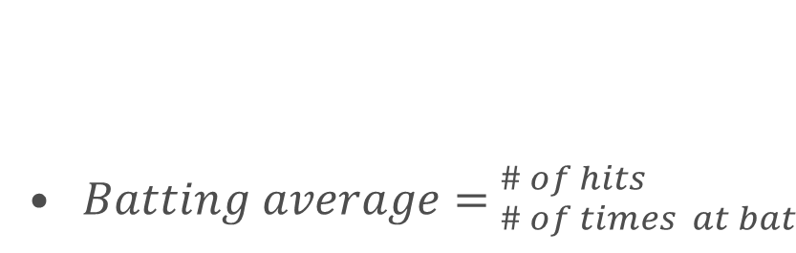
Context of the case
Marginal Product
It is above average product when average product is rising
Game | Times at Bat | Hits | Accrued | Avarage | Marginal
1 | 1 | 0 | 1 | 0 | 0,000
 | 2 | 0 | 0 | 0,000
 | 3 | 0 | 0 | 0,000
 | 4 | 1 | 1 | 0,250
 | 5 | 1 | 2 | 0,400 | 0,400
2 | 6 | 1 | 3 | 0,500
 | 7 | 0 | 3 | 0,429 | 0,500
3 | 8 | 0 | 3 | 0,375
 | 9 | 0 | 3 | 0,333
 | 10 | 0 | 3 | 0,300 | 0,000
4 | 11 | 0 | 3 | 0,273
 | 12 | 0 | 3 | 0,250
 | 13 | 1 | 4 | 0,308
 | 14 | 0 | 4 | 0,286
 | 15 | 0 | 4 | 0,267
 | 16 | 1 | 5 | 0,313 | 0,333
Marginal Product
It is below average product when average product is falling
${Batting average= }_{\# of times at bat}^{\# of hits }$

Slide 3
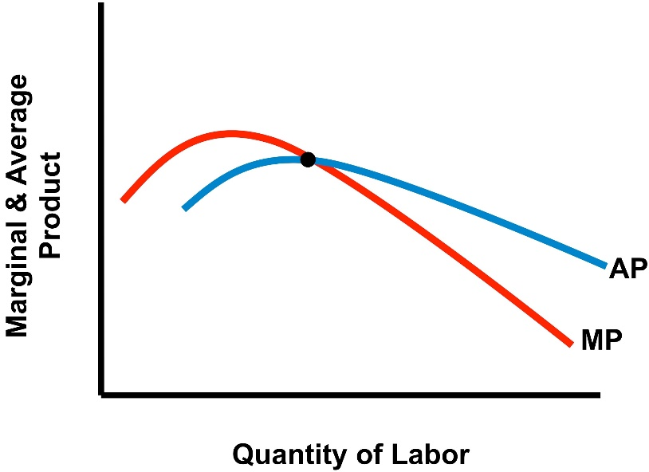
Economic Topic
Marginal Product
The additional output created as a result of additional input placed into.
Average
A single value (such as a mean, mode, or median) that summarizes or represents the general significance of a set of unequal values
Average product shows output at a specific level of input
Notes:
Marginal product focuses on the changes between production totals and the quantity of resources.
Average product shows output at a specific level of input.
The peak of the average product curve is the point at which the marginal product curve and average product curve intersect. For the points below (to the left of) this point, the marginal product of the extra input is higher than the average product.
At the point of intersection, the additional worker produces the same as the average product of the total workforce; there will be no change. The marginal product curve may fall to zero, showing that an additional worker will have no impact on production; for example, if there is no more space left to work in, or if machines are working at 100% capacity and all raw materials have been used up.

Slide 4

Graphic
These linear interpolation are modeling the behavior between marginal product and average product, in the first section the curve doesn’t have the behavior expected, because the amount of data is not enough to represent the system. If you have a limited data the fluctuation will be higher. Once, the data base increase we got the expected out come. The inaccuracy of the model through interpolation is evidenced at the end of the graph, which depends on the degree of polynomial used on it.

